Slide 1
An Efficient Parallel Keyword Search Engine on
Knowledge Graphs
Yueji Yang , Divykant Agrawal, H.V. Jagadish, Anthony K. H. Tung, Shuang Wu

Slide 2

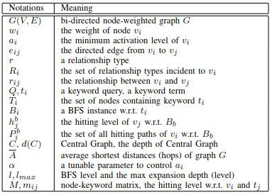
Definitions
r_{ij} is the labelled on edge e_{ij}
BFS instance B_{i} starts from a set of nodes at the bottom level (0)
Each node can only be hit once in terms of one BFS instance
Each keyword t_{i} corresponds to a BFS instance B_{i}

Slide 3
Hitting level + path
Hitting level (h_{j}^{b} ) -> With BFS instance B_{b} , the hitting level of node v_{j} denoted by h_{j}^{b} is the first BFS expansion level l where v_{j} becomes a frontier to expand in B_{b}
E.g. For B₁, v₁ and v₂ has a hitting level of h₁¹ = h₂¹ = 0 since they are source nodes that expand at level 0. h₃¹ = h₄¹ = 1 because v₃ and v₄ are hit at BFS level 0 and become frontiers at level 1. v₃ will not expand to v₄ in B₁ since v₄ has already been hit
Hitting path -> Given BFS instance B_{b}, the hitting path of a node v_{j} is any expansion path (from source nodes) that hit v_{j} and make it a frontier in the next expansion level. P_{j}^{b} = set of all hitting paths of v_{j} w.r.t. B_{b}
For B_{1,} and v₄ , only v₁ -> v₄ and v₂ -> v₄ are hitting paths. v₁-> v₃ -> v₄ is not since it is not an expansion path. There is no expansion from v₃ and v₄.

Slide 4


Central graph
Central graph -> Given keyword query Q={t₀…t_{q-1}}, for node v_{j} , if P_{j}^{i} != ∅ (w.r.t. T_{i} (set of all nodes containing the keywords) and B_{i} (BFS instance)) for every i, then define the central graph centered at v_{j} as
(union of all hitting paths that center v_{j} where v_{j} is the Central Node which includes all keywords)
The size/depth of the central graph C is the largest hitting level of Central Node v_{j} with the following equation

Slide 5
Central graph cont.
Central graphs contain 3 conditions
Must contain all hitting paths from all input keywords and thus connect each keyword
For one keyword, a central graph contains all its hitting paths to the central node (allows multi-paths for every keyword). These hitting paths are the “shortest” in terms of hitting levels of the central node.
Depth of central path is bounded by the max hitting level of the respective central node
Example of central graph
Above, there are 2 central graphs. One centered at v₃ with depth 1, covering hitting paths v₀->v₃ and v₁->v₃. The other is centered at v₄ with depth 2, covering hitting paths v₀->v₃->v₄, v₁->v₄ and v₂->v₄.

Slide 6
top-(k,d) Central Graphs
Given keyword query Q and number k, find all central graphs with a depth no larger than d such that d is the smallest possible value to obtain at least k central graphs
k = number of central graphs to obtain
d = max depth of central graphs

Slide 7
Minimum activation level
Use minimum activation level to weigh graph to generate meaningful answers
Minimum activation level (denote as a_{i} for v_{i}) lower bounds the hitting level of a vertex. It makes vertices active for exploration.
Summary node = node with large number of same labelled edges and small number of different edges
Degree of summary = node to which extent tends to be a summary node (use it for weighing graphs, shown next slide)

Slide 8

Calculate minimum activation level
Let R_{i} denote set of in-edge labels incident to v_{i}, for r in R_{i}, let ṝ denote the number of in-edges of label r pointing to v_{i} .
Weight calculated below using degree of summary of a node v_{i}:
Can normalize w_{i} and denote this as w_{i}’ . Use the min/max weight w from all nodes v_{0…n} in V.

Slide 9
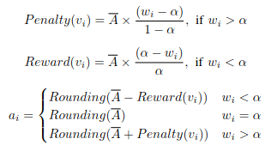
Calculating minimum activation level - cont.
Penalty and Reward mapping used to obtain activation level a_{i} for w_{i} with tunable parameter α ∈ (0, 1)
α allows users to set preference for degree of summary in runtime
First compute average distance (hops) between 2 nodes by sampling (Ā)
Calculate a_{i} by increasing penalty or decreasing reward using α and w_{i} from the average distance and round to nearest integer
Let Ā denote the average shortest distance between 2 nodes for G
Notes:
Could apply a shortest path algorithm like Dijskstra’s and take the shortest distance between a source and one of multiple destinations. Apply this to all vertices as the source, then compute the average shortest distance. (All pairs shortest paths)

Slide 10
Calculating (Ā) - average shortest distance
Compute the all-pairs shortest path (Floyd-Warshall) and get the average for each shortest path of each vertex
https://www.tutorialspoint.com/all-pairs-shortest-paths

Slide 11
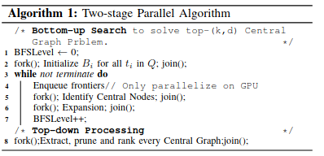
Two-Stage Parallel Algorithm
Graph stored in CSR (Compressed Sparse Row Format)
Bottom-up Search (Initialization for 3 data structures)
FIdentifier records 1 for nodes becoming frontiers in the next iteration, or else 0. (size=Θ(|V |))
CIdentifier records 1 for nodes identified as central nodes, or else 0. (size=Θ(|V |))
Initialize a node-keyword matrix M where m_{ij} records the hitting level of v_{i} for keyword t_{j} . m_{ij} = 0 if v_{i} contains keyword otherwise set to ∞. (size=Θ(|V |q) where q=#of keywords). For GPU initialization, initialize M on GPU and transfer back to CPU after search is done.
v1
M | t₁=pastry | t₂=pie
v₁ | 0 | ∞
v₂ | ∞ | 0
v₃ | ∞ | 0
v2
Fruit pastry {pastry}
cherry pie {pie}
v3
apple pie {pie}

Slide 12
Two-Stage Parallel Algorithm - Cont.
Enqueueing frontiers
At the beginning of each iteration (a new expansion level), extract and enqueue nodes into the frontier queue by examining the flags in FIdentifier which was modified in the last iteration or initialization phase. Enqueue nodes with FIdentifier=1 into the frontier queue.
On GPU, parallelize the process of checking FIdentifier and enqueueing nodes with lock. (Too expensive on CPU, so don’t do on CPU)
A node becomes a frontier as long as it is in any BFS instance (i.e. different BFS instances share a frontier)
After enqueuing frontiers at every iteration, set all FIdentifier to 0 in parallel on GPU

Slide 13
Two-Stage Parallel Algorithm - Cont.
Identifying central nodes
Using M, can identify where v_{i} is a central node by checking m_{ij} for each keyword t_{j}. Only need to look at frontiers.
Assuming max depth=3 and frontiers contain {v₁,v₂,v₃,v₄}, v₁ and v₄ are central nodes, but v₂ is not since it has not been hit by all keywords. V₃ is a central node but since it has a hit level of 4 with respect to t₁ which exceeds the max depth, we won’t generate a central graph on v₃. We will generate 2 central graphs where v₁ and v₄ at this point.
M | t₁ | t₂ | t₃
v₁ | 3 | 2 | 1
v₂ | ∞ | 2 | 1
v₃ | 4 | 1 | 1
v₄ | 1 | 1 | 1
v₅ | ∞ | ∞ | 1
v₆ | 2 | 0 | ∞
Notes:
A central node is when a vertex can be joined to hit paths containing all keywords

Slide 14
Two-Stage Parallel Algorithm - Cont.
Alg 1: Two-stage parallel algorithm
/* Bottom up search */
Int FIdentifier[|V|] = set keyword nodes to 1, else 0
Int CIdentifier[|V|] = zeros(|V|) //zeros since we can call IdentifyCentralNodes(...) using M
Int M[|V|][|q|] = set 0 if keyword contained, else infinity //initialize on GPU, transfer back to CPU when search is done
Int NodeWeights[|V|] = CalcWeights(...) //gets degree of summary
Int Alpha = …
Int k = …
twoStageParallelAlg() :
Int BFSLevel = 0
fork(); Int BFSInstance[][] = instances for each keyword, add all keyword nodes to each instance //size(|V|,|q|) join();
While not terminate do
Enqueue frontiers of nodes with FIdentifier = 1 //parallelize on GPU with lock
fork(); CIdentifier = IdentifyCentralNodes(M,FIdentifier); //sets CIdentifier as 1 for nodes where FIdentifier=1 join();
set FIdentifer[|V|] to all 0 in parallel on GPU
fork(); M, FIdentifier = Expansion(G,M,frontiers,NodeWeights,BFSLevel,alpha); join(); //Alg 2
BFSLevel++;
/* Top-down Processing */
Node CentralNodes[] = getCentralNodes(CIdentifier) //add all nodes where CIdentifier = 1
fork(); TopDownProcessing(G,M,CentralNodes,NodeWeights,Alpha,k); join(); //Alg 3
Notes:
Since OpenMP is used, can probably just use parallel for loop

Slide 15
Two-Stage Parallel Algorithm - Cont.
Alg 1: Two-stage parallel algorithm
/* Bottom up search */
Int FIdentifier[|V|] = set keyword nodes to 1, else 0
Int frontiers[|V|] //our queue (initalize to all 0’s)
Int CIdentifier[|V|] = zeros(|V|) //zeros since we can call IdentifyCentralNodes(...) using M
Int M[|V|][|q|] = set 0 if keyword contained, else infinity //initialize on GPU, transfer back to CPU when search is done
Int NodeWeights[|V|] = CalcWeights(...) //gets degree of summary
Int activation[|V|] = CalcActivation(NodeWeights,alpha)
Int Alpha = …
Int k = …
String keywords[|q|] //array of all keywords in the query
twoStageParallelAlg() :
Int BFSLevel = 0
While not terminate do
Enqueue frontiers of nodes with FIdentifier = 1 (copy FIdentifier to frontiers)
#pragma omp for
set FIdentifer[|V|] to all 0 in parallel
CIdentifier = IdentifyCentralNodes(M,frontiers,keywords); //sets CIdentifier as 1 for nodes but only check when FIdentifier=1 use #pragma omp for inside function instead of fork
M, FIdentifier = Expansion(G,M,frontiers,FIdentifier, CIdentifier, activation,BFSLevel,alpha,keywords); //Alg 2
BFSLevel++;
/* Top-down Processing */
TopDownProcessing(G,M,CIdentifier,,NodeWeights,Alpha,k); //Alg 3
Notes:
Since OpenMP is used, can probably just use parallel for loop
https://stackoverflow.com/questions/2396430/how-to-use-lock-in-openmp
Fork is not needed, just use parallel for inside the functions that require parallelism

Slide 16
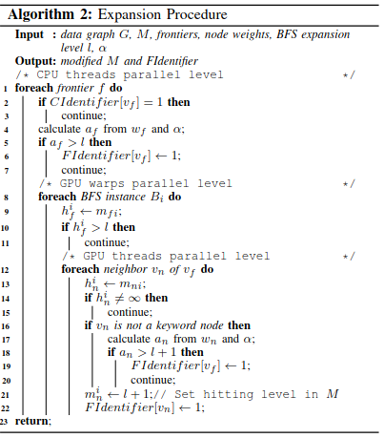
Expansion Procedure
Skip frontiers that are marked as central nodes
If the frontier’s activation level is greater than l, keep it in the frontier and move on
For each BFS instance, skip the frontier if hit level > l
Add neighbor of the the frontier to the next frontier if it does not have a keyword and the activation level is l or lesser
Goal: Perform expansion on the graph to get the hit levels for M and identify central nodes
Have visited / contains a keyword, skip
Keyword nodes are marked with a keyword
Notes:
Activation function can be calculated using the penalty and reward mapping of the normalized weights

Slide 17
Expansion Procedure - Parallelism
On the GPU, let a warp handle one BFS instance of a frontier v_{f}. The threads within a warp handle different neighbours of v_{f}
Warp = group of threads active simultaneously in SIMD model
Use coarse grain parallelism (higher computation, lower communication)
Let CPU threads handle different frontiers with a dynamic scheduling which means that once a thread finishes a frontier, it looks for another
Parallelism and dynamic scheduling done on OpenMP
Have visited / contains a keyword, skip
Keyword nodes are marked with a keyword

Slide 18
Expansion Procedure - Parallelism
Expansion(G, M, frontiers, FIdentifer,activation, BFSLevel, alpha,keywords):
#pragma omp for collapse(3) schedule(dynamic)
For v_{f}=0….|V|-1
If frontiers[v_{f}] == 1
If CIdentifier[v_{f}] = 1 then
Continue;
If a_{f} > l then
FIdentifer[v_{f}] = 1
Continue
for i=0…q-1 (index that corresponds to each BFS instance B_{i} for t_{i})
h_{f}^{i} -> m_{f}^{i}
If h_{f}^{i} > l then
continue;
foreach neighbor v_{n} of v_{f} do
h_{n}^{i} <- m_{n}^{i}
If h_{n}^{i} != ∞ then
continue;
If !( v_{n} ).contains(keyword[i]) then
If a_{n} > l+1 then
FIdentifer[v_{f}] = 1
Continue
m_{n}^{i} = l+1
FIdentifer[v_{n}] = 1;
Return modified M and FIdentifier
Have visited / contains a keyword, skip
Keyword nodes are marked with a keyword
Notes:
Algorithm 2 is a lock-free procedure and all reads and writes are guaranteed correct.

Slide 19
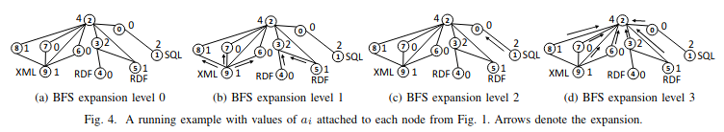
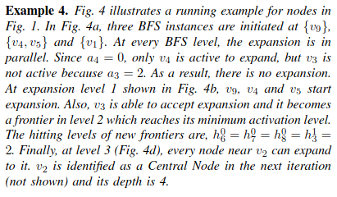
Expansion Procedure - Example

Slide 20
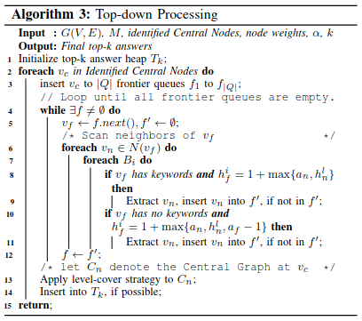
Top-down processing
3 steps
1) Extract respective Central Graphs
2) Apply level-cover strategy to all central graphs to prune redundant nodes based on keyword co-occurrence
3) Select final top-k answers by a scoring function
Goal: construct central graphs, return top(k,d) graphs based on top k highest ranked results

Slide 21
Top-down processing cont.
Parallelism Strategy
Let one thread to recover one or more Central Graphs
Dynamic scheduling handled by OpenMP
Implement top-down process on CPU

Slide 22
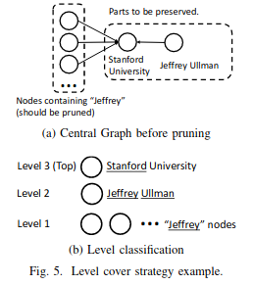

Top-down processing cont.
Level-cover strategy
Classify only keyword nodes within a Central Graph into different levels based on the number of keywords they contribute
Central Node is always at top level
Proceed in a greedy manner starting downwards from top level where nodes contain the most keywords
If nodes in one level cover all keywords, prune all nodes in the rest levels along with hitting paths from pruned nodes to Central Nodes
Preserve as many keyword nodes as possible since nodes will not lead to pruning of nodes in the same level

Slide 23

Top-down processing cont.
Scoring function
Select final top-k answers from pruned top(k,d) Central Graphs using a ranking function to restrict its width
C=Central graph
λ>=0 (parameter to control effect of CG depth), set λ=0.2 by default
Use central graphs of top k highest scores to put into the answer heap

Slide 24
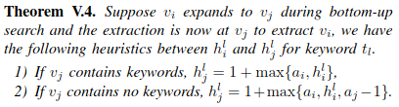
Top-down processing cont.
Initialize frontier queues for each keyword in a query (|Q| = number of keywords in a query)
For each frontier, apply theorem V.4 between the frontier and its neighbours to see whether a neighbour can be recovered w.r.t. a keyword t_{i}
Get the central graph C_{n} by having a copy of v_{c} and adding neighbours to it and other nodes and edges through extraction done on line 9 and 11
Level-cover strategy applied to C_{n} on line 13 (need to use the constructed central graph from extraction and M for level cover strategy), choose top-k based on scoring function
Insert pruned graph from top-level strategy to top-k answer heap (T_{k})
Notes:
For level-cover strategy, we need to scan all hitting levels of all keyword nodes. To prune, we scan from top to bottom level.

Slide 25
Top-down processing cont.
TopDownProcessing(G,M,CentralNodes,NodeWeights,Alpha,k):
Node* heap[k];
Initialize f₁…f_{q} //frontiers for each keyword
Initalize levels[] // will represent the level classification for each central graph
foreach v_{c} in CentralNodes do
foreach f₁…f_{q} do
f.insert(v_{c})
NewC = new graph starting at v_{c}, will be the central graph
while there exists a frontier f that is not empty:
v_{f} -> f.next(), f’ -> NULL
foreach v_{n} in Neighbours(v_{f}) do
foreach B_{i} do
If v_{f} has keywords and h_{f}^{i} = 1+max(a_{n}, h_{n}^{l})
Connect v_{n} to NewC, insert v_{n} into f’ if not in f’
If v_{f} has no keywords and h_{f}^{i} = 1+max(a_{n}, h_{n}^{l},a_{f}-1)
Connect v_{n} to NewC, insert v_{n} into f’ if not in f’
f -> f’
level = LevelCoverStrategy(NewC,M)
levels.insert(level)
SortbyScoring(levels) //get score for each levelled central graph and sort by score defined by the scoring function
Insert levels into heap[k] if possible //add top k levels into heap[k]
Notes:
For level-cover strategy, we need to scan all hitting levels of all keyword nodes. To prune, we scan from top to bottom level.

Slide 26
Top-down processing cont.
TopDownProcessing(G,M,CIdentifier,NodeWeights,Alpha,k,keywords):
Node* heap[k];
Initalize CentralGraphArray[] // will represent the level classification for each central graph
#pragma omp for schedule(dynamic)
for i=0…|V|-1
If CIdentifier[i]==1 do:
Initialize queue f[|q|] //frontiers for each keyword (array of queues of size q)
Create central vertex v_{c} from index i
for j=0…q-1 do
f[j].push(v_{c})
NewC = new graph starting at v_{c}, will be the central graph
Bool frontiers_empty = allFrontiersEmpty(f)
while frontiers_empty == false:
k=0;
f2 = f
while(f2[k].empty()==true and k<q) //looks for a non-empty frontier
k=k+1;
if(k>=q) {
break;
}
v_{f} -> f[k].pop(), f’ -> NULL
foreach v_{n} in Neighbours(v_{f}) do
for k_i=0…q-1
If v_{f}.contains(keywords[k_i]) and h_{f}^{k_i} = 1+max(a_{n}, h_{n}^{l})
Connect v_{n} to NewC, push v_{n} into f’ if not in f’
If !v_{f}.contains(keywords[k_i]) and h_{f}^{k_i} = 1+max(a_{n}, h_{n}^{l},a_{f}-1)
Connect v_{n} to NewC, push v_{n} into f’ if not in f’
f[k] = f’
frontiers_empty = allFrontiersEmpty(f)
prunedCentralGraph = LevelCoverStrategy(newC, keywords)
#pragma omp critical {
CentralGraphArray.insert(prunedCentralGraph)
}
SortbyScoring(CentralGraphArray) //get score for each levelled central graph and sort by score defined by the scoring function
Insert CentralGraphArray into heap[k] if possible //add top k graphs into heap[k]
Notes:
For level-cover strategy, we need to scan all hitting levels of all keyword nodes. To prune, we scan from top to bottom level.
Later check if adding vertex to central graph should be vertex or edge induced. When adding v(n), should we add all the other edges that correspond to that v(n)?

Slide 27
Level cover strategy algorithm
LevelCoverStrategy(newC, keywords):
min = GetMinNumberOfKeywordsToPreserve(newC, keywords) (see slide 28 for details)
root = newC.root() //central node (copy of the original graph newC)
prunedGraph = root //newly constructed pruned graph
Initialize frontier
frontier.push(root)
added[|V|] = initalize all to false
added[root.index()] = true
vector<int> distfromC[|V|] = initialize to all infinity
distFromC[root.index()] = 0
While frontier is not empty
curr = frontier.pop();
node_keywords = getKeywords(curr.label(), keywords) //get all keywords from label of v_{n} that is part of the keyword query e.g. [k1,k2,k3]
number_of_keywords = length(node_keywords)
If number_of_keywords >= min
JoinShortestPath(curr, distfromC, added, prunedGraph) //join shortest path curr -> … -> (last node not added) onto prunedGraph (see slide 29)
For all incoming neighbours v_{n} of curr:
if distFromC[v_{n}.index()]==infinity
distFromC[v_{n}.index()] = distFromC[curr.index()] + 1
If v_{n} is not in frontier
frontier.push(v_{n})
Return prunedGraph
Notes:
//Return: Generates a new graph called prunedGraph which preserves some nodes from the original graph newC. Use BFS to look at each node to check if it should be preserved based on how many keywords it has. If it has enough keywords, add it to the prunedGraph and return the prunedGraph.
May need an array of pointers to keep track of pointer of each node at a specific node index from 0 to |V|-1
LevelCoverStrategy looks at the central node and neighbours that have an incoming edge to it. JoinShortestPath looks at a node that should be preserved and neighbours that have an outcoming edge to it, pointing towards the central node.
JoinShortestPath is looking upwards towards the central node rather than downwards like in LevelCoverStrategy and finds all min paths for a vertex.

Slide 28
Level cover strategy algorithm - level classification
GetMinNumberOfKeywordsToPreserve(G, keywords): //keywords is an array with a list of keywords in the query
vector<vector<string>> levelClass[|q|][|V|] //|q| = number of keywords in the query
levelClass[|q|-1].push(G.root().label())
Initalize frontier
Initalize explored[|V|] = {set all to false}
explored[G.root().index()] = true
frontier.push(G.root())
While frontier is not empty
curr = frontier.pop()
if(curr!=G.root())
curr_keywords = getKeywords(curr.label(), keywords) //returns array of all keywords from node label
If length(curr_keywords)!=0
levelClass[length(curr_keywords)-1].push(curr.label());
For all neighbours v_{n} of curr
If explored[v_{n}] == false
explored[v_{n}] = true
frontier.push(v_{n})
//return min number of keywords that a label must have for its corresponding node to be preserved
keywords_to_scan = keywords
For i=(|q|-1)…0
For j=0…length(levelClass[i])
splitLC = levelClass[i][j].split(“”)
For k=0…length(keywords_to_scan)
If keyword_to_scan[k]==””
continue
For L=0…length(splitLC)
If keywords_to_scan[k] == splitLC[L]
Keywords_to_scan[k] = “”
Break
If all elements in keywords_to_scan are “”
Return i+1
Notes:
//Return: A number representing the min number of keywords that a node should have to be preserved in the constructed graph (prunedGraph) from the level cover strategy algorithm. We decide the min number by dividing all all labels into levels where each level is a representation of how many keywords the label has. We start from the upward level (most keywords) and go downwards (less keywords) and preserve the least number of levels that contain the max number of keywords. So if all the keywords have already been found in one level and the previous ones above it, we prune the rest of the levels and preserve the nodes from the upper levels where all the keywords were already found.
We construct an array of vectors (levelClass) where index i+1 denotes the number of keywords from the query (level classification). The last index stores the label of the central node. E.g. Query=”Stanford, Jeffery, Ullman”. LevelClass[0]= [Jeffery A, Jeffrey B… Jeffery C], LevelClass[1] = [Jeffery Ullman], LevelClass[2] = [Stanford University].
Example of how this algorithm is used: We have a query={S,J,U,B} and for LC (levelClass), LC[2] = {SUB}, LC[1]={UB, JB}, LC[0]={J,J,U,B,S,B,U}. We preserve the labels in LC[2] and LC[1] since these levels already cover all the keywords. We can see that the minimum number of keywords that should be kept is 2 from LC[1]. So we return the min number of keywords which is 2.

Slide 29
Level cover strategy algorithm - Shortest Path
JoinShortestPath(&last_node, &distfromC, &added, &prunedGraph)
Path = last_node (copy from the original graph)
frontier = []
frontier.push(last_node)
notaddedVerticesToJoin = []
addedVerticesToJoin = []
While frontier is not empty
curr = frontier.pop()
minCost = distfromC[curr.index()] - 1
For all outgoing neighbours v_{n} from curr //add vertices with min cost to graph
If distfromC[V_{n}.index()] == minCost
If added[v_{n}.index()] == false
Join path[curr.index()] -> v_{n} (copy from the original graph)
frontier.push(v_{n}) if v_{n} is not in frontier
Else If added[v_{n}.index()] == true
notaddedVerticesToJoin.append(curr.index())
addedVerticesToJoin.append(v_{n}.index())
For i=0…len(addedVerticesToJoin)-1 //Join the constructed path with the pruned graph
Join prunedGraph[addedVerticesToJoin[i]] <- path[notaddedVeticesToJoin[i]]
For all nodes n in path
added[n.index()] = true
Notes:
//Goal: finds the shortest path to the central node and adds the shortest path to the pruned graph
May need an array of pointers to keep track of pointer of each node at a specific index from 0 to |V|-1. Will have to create an array of pointers for both the constructed path and the pruned graph

Slide 30

Top-down processing - output
Assuming that the top-k answer heap (T_{k}) is an AVL/height balanced tree (since insertion time complexity is O(log2(n)) according to the paper), the output of top-down processing would look something like this for the query SELECT “Jeffrey”, “Ullman”, “Stanford”
For top-(k,d) central graphs, assume k=4, so the heap has 4 nodes.
Highest S(C)
Second highest S(C)
Third highest S(C)
Stanford University
…
Alumni
Jeffrey M. Ullman
Fourth highest S(C)
Stanford University
Students
Jeffrey A. Ullman
Notes:
Can store central graphs in priority queue

